Slide 1
Screen Time App
Group Members:
Ali Raza
Umair Habib
Ahmed Bilal

Slide 2

What Why How

Slide 3

What
Screen Time App is an application that
Controls phone’s screen
Blocks particular apps
Monitor the user activity

Slide 4

Why
Helps user to minimize over usage of his phone
Helps to prevent phone checking addiction
Maintain the stats. of mobile phone usage time on daily and weekly basis
WHYYY!!!

Slide 5

How
Accessibility Service is used
Provides ease to user with disabilities in using Android devices and apps

Slide 6
Accessibility Service Steps
2.XML Config file
3.Accessibility
Service Class
4.@override
5.Call Accessibility
Service
1.Manifest

Slide 7
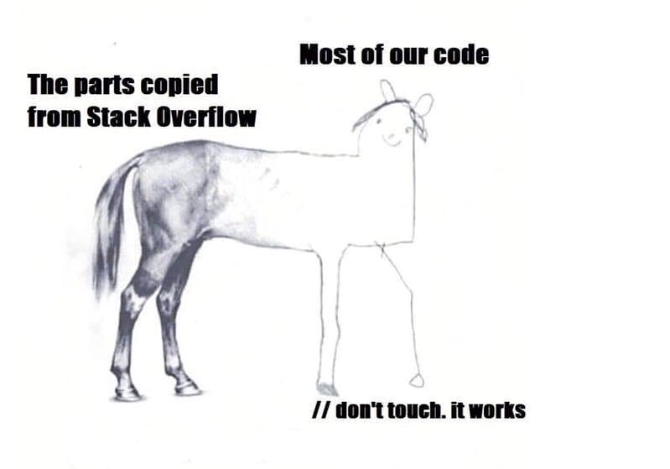
Code
Let’s Check the Code

Slide 8
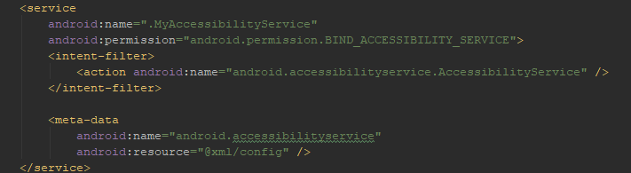
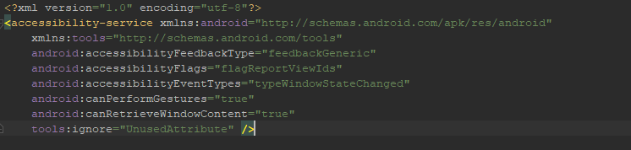
Manifest.xml
Xml/config.xml

Slide 9
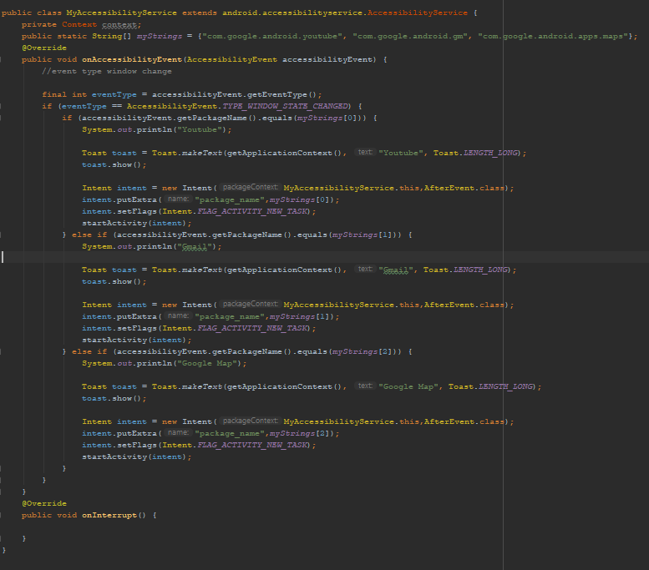
MyAccessibilityService.java

Slide 10
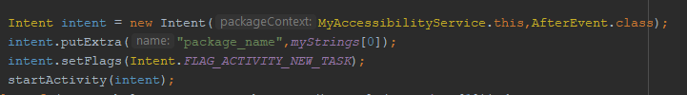
Method for calling

Slide 11



At Last
Screen Time Permission

